Slide 1
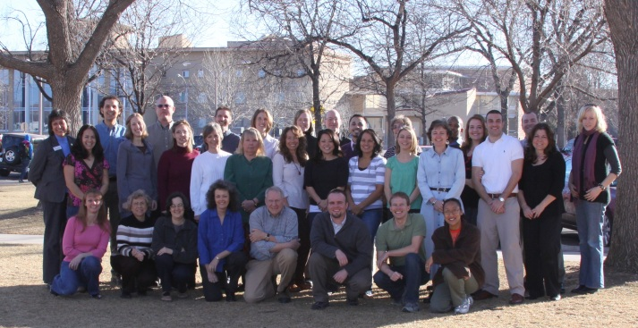
Center for Advising and Student Achievement (CASA)
Program Review 2003-2007
Health Profession Advising
Key Communities
Orientation and Transition Programs
Outreach and Support
Undeclared Advising
Five External Reviews, first on-line review, resulted in broader staff participation in assessment

Slide 2
Center for Advising and Student Achievement Strengths
Comprehensive and collaborative services
Dedicated and competent staff
Expanded services and resources

Slide 3
Administrative and Technology service Overview
Each semester 3,800 advising appointments, 900 walk-in appointments, and an average of 11,000 phone calls
Between fall 2003 and fall 2007, there were over 212,000 logins at the Undeclared Computer Labs, for 41,000 students

Slide 4
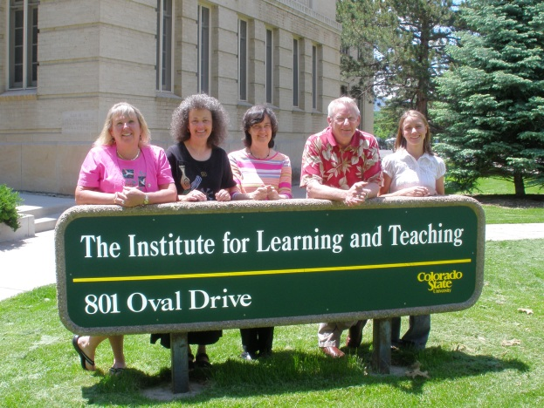
Health Profession Strengths
Full time advisors
Each advisor is focused on 1-3 professional programs
Housed in a centralized office rather than a college or department

Slide 5
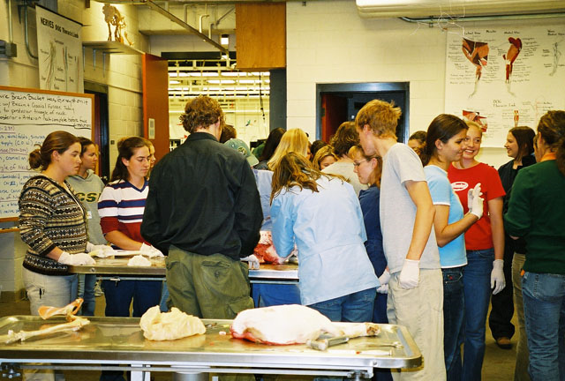
Health Profession Highlights
Pre-Health Student Organizations offer students significant experiential opportunities
Each semester, advisors have over 2,000 total contacts (appointments, phone and e-mails) with students, faculty/staff, and alums
MCAT Prep Course

Slide 6
Health Profession challenges And Recommendations
Increase the awareness of health profession advising services
More time and energy developing the skills and experiences to prepare students to be a successful candidate for professional schools
Develop more outreach programs for underserved populations

Slide 7
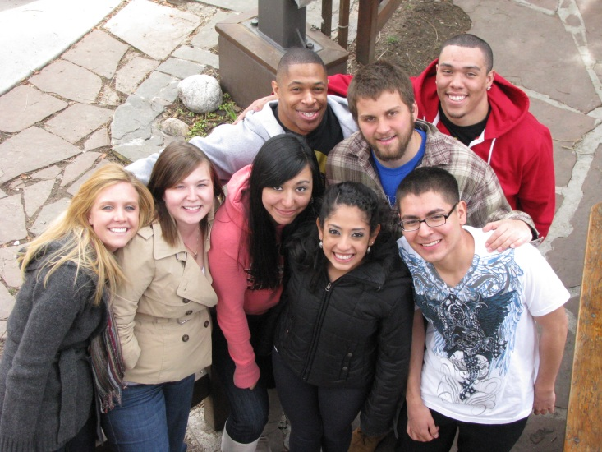
Key Communities Strengths
Grown from 218 students to 386 in Key Academic, Key Service, Key Plus and Network CSU
Full time staffing and peer mentors
Focus on active and experiential learning
Strong collaboration with Housing

Slide 8
Key Communities highlights
Student Diversity-40% of 370 participants identified as Students of Color and 28% were the first in their families to attend college.
Academic Performance-Participants in the Key Academic Community earn higher grade point averages for the fall term than the University average.
Persistence- Key Academic students are more likely to be retained to the second year than the University average. The difference is greatest for students of color (6.5 percentage points) and nonresidents (12.2 percentage points) at nearly every Index range.

Slide 9
Key Communities challenges and recommendations
Reevaluate the spring academic course structure
Determine how first year seminars fit with the overall structure
Enhance communication by developing a system where students can track program participation requirements.

Slide 10
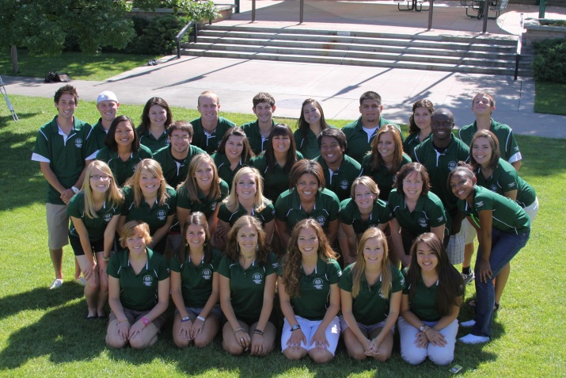
Orientation and Transition Programs strengths
Small group meetings
Parent/family programming
Student Staff
Balance of personal and academic transition
Transfer specific programming
Data driven programs
Campus wide program with strong collaboration across the Division and the campus

Slide 11
Orientation and Transition Programs Highlights
Expanded to include Transition Programs in 2007 (Started with 1 professional and 1 GA; now 4 professionals and 2 Gas)
Integrate four foundational values (Academic Excellence, Community, Diversity, Active Engagement)
Retention – of the first year students who attend Preview, 84% returned to CSU for a second year whereas first year students who did not attend Preview returned at a lower rate of 43%

Slide 12
Orientation and Transition Programs challenges and recommendations
Space, number of sessions, weekend sessions
Large group advising; need to increase individual interaction
Personalization to specific populations
Increase the connection between orientation, welcome week and transition programs.

Slide 13
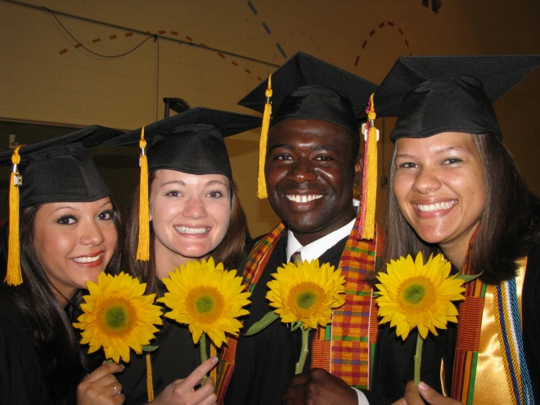
Outreach and support strengths
Additional staff to implement the Student Success Initiatives
Proactive contact before students begin college
Student advocates with strong collaborative relationships across campus

Slide 14
Outreach and support highlights
First Generation Award Retention
Over a seven year period, freshman recipients of the First Generation Award have shown a first-year retention rate that averages ten points higher than other first generation college students.
Graduation Outreach Project
In 2007, the first year of this project, 147 students were identified from the fall 2002 cohort and of that group, outreach was provided to 84 students (57%), has directly impacted the graduation of 5 students (3%), and has moderately impacted the graduation of 22 students (15%).

Slide 15
Outreach and support challenges and recommendations
Increase student success in terms of academic standing and graduation rates for a larger number of students.
Enhance the Taking Stock program by offering it to more students and expanding access to more campus staff members.

Slide 16
Undeclared advising strengths
Student outreach- In Fall 2007, 88% of freshman undeclared students were advised for spring semester
Programming- Major exploration such as major’s fairs, workshops, and programs in residence halls
Campus wide functions- working with all probationary students, university withdrawals, and tuition assessment appeals

Slide 17
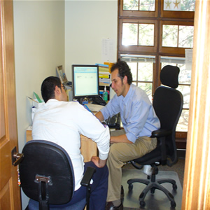
Undeclared advising highlights
Advisors have a smaller case load (reduced from 500 to 350).
90% of University Open Option students starting as new freshman in fall 2004 had declared a major by 45 credits, compared to 87% of students starting as new freshman in fall 2002.
Transfer students with over 60 credits declined from 12.77% in fall 2004 to 9.38% in fall 2007.

Slide 18
Undeclared advising challenges and recommendations
Develop enhanced ways to support probation students
Starting a University-wide Advising Group
Enhance and develop new communication strategies

