Slide 1
CSU Student Legal Services
User Research Results
August 2011
Paula Curtis
User Experience Research
paula@advmediaservices.com
970.310.9171

Slide 2
CONTENTS
03 EXECUTIVE SUMMARY
06 APPROACH
08 PHASE ONE RESULTS
09 Behavior & Expectations
11 Feedback on SLS Site
12 PHASE TWO RESULTS
13 Legal Issues Important to Students
14 Feedback on Current SLS Outreach Efforts
15 Ways to Get the Word Out
16 RECOMMENDATIONS
17 SLS Site
19 Getting the Word Out
2

Slide 3
EXECUTIVE SUMMARY

Slide 4
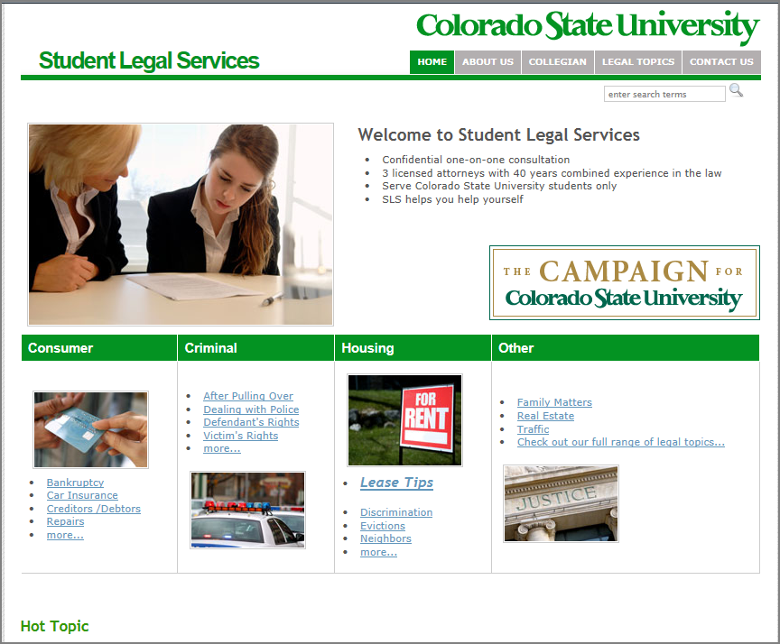
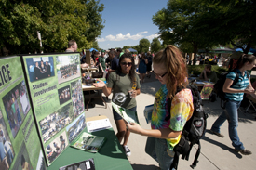
EXECUTIVE SUMMARY
What We Did
Conducted observational interviews with six CSU students to understand how they get answers online. They were given typical scenarios, such as breaking a lease or dealing with alcohol –related charges (MIP, DUI). After doing their own natural exploration, students were directed to the Student Legal Services website.
Followed-up the interviews with two focus groups. Each group consisted of eight students. Groups discussed the legal issues that are most important to them and brainstormed how to get the word out – about legal services that are available when they get into trouble - and how to prevent trouble in the first place.
What We Learned
The informational pages on the SLS website are pretty good. The level of information is about right. The trouble is that most students wouldn’t think to go to the site. Unless a google search jumps to the right page, students also have trouble navigating the menu structure.
A bigger challenge is getting the word out to students about Student Legal Services. Unless they had prior interactions with SLS, most students didn’t know the department existed and that services were free for them. They also didn’t realize the breadth of issues they could get help with.
4

Slide 5
EXECUTIVE SUMMARY
Recommended Next Steps
On campus, there are lot of groups competing for student attention. Try a couple of new approaches…
Instead of writing columns for the editorial section of the Collegian, place brief provocative teasers (with interesting legal facts or headline) on the back page of the paper. Embed a QR code for a quick link to the SLS website to read more.
Make use of campus-wide e-mails to advertise a 2-3 minute legal trivia quiz with give-aways (bribe students to participate). The quizzes can be designed to educate students on particular topics, such as housing issues or dealing with the police.
Design and post visually eye-catching posters with brief messages related to SLS.
Improve the SLS website
Most students rely on google search to find information. So, improve the site’s google ranking by employing search engine optimization.
Revise the menu structure to better reflect how students look for topics. (less legalese)
Update the home page
Example of a poster designed to catch students’ attention
5

Slide 6
APPROACH

Slide 7
APPROACH
Research Objectives
To understand student expectations and use of the CSU Student Legal Services website (sls.colostate.edu) in order to improve the user experience
To prioritize improvements in content, organization and searchability of the site to better help students prevent or get help with legal issues
To learn more effective ways to “get the word out” to students about Student Legal Services
Methodology
It’s cool that CSU has lawyers here available that I can talk to. My first thought was that I’m on my own here… Does it cost money to consult with a campus lawyer?
~ Freshman
Research was conducted in two phases. Phase one consisted of six, one-on-one interviews. Each student was given a couple of typical legal scenarios (breaking a lease and MIP/DUI) and asked to get more information. The one-hour interviews were conducted in the SLS office on 6/20/11 and facilitated by a researcher. Students were asked to use a “think aloud” protocol.
In phase one, the students represented a mixture of gender (3 male, 3 female) and age (1 freshman, 2 sophomores, 2 juniors, 1 senior). One student was an exchange student from China.
Phase two consisted of two focus groups that were conducted a week later. Each focus group was composed of eight students, representing a diverse mix of age, area of study, traditional/non-traditional, and gender. Most of the students in the first group had heard of SLS, but hadn’t interacted with it. Several students in the second group had previously consulted with SLS on a variety of issue. Based on the learning from phase one, the focus groups discussed these topics, rather than the existing SLS website:
What kind of legal issues are important to students?
What are effective ways to let students know about Student Legal Services?
How effective are current outreach efforts?
7

Slide 8
PHASE ONE RESULTS

Slide 9
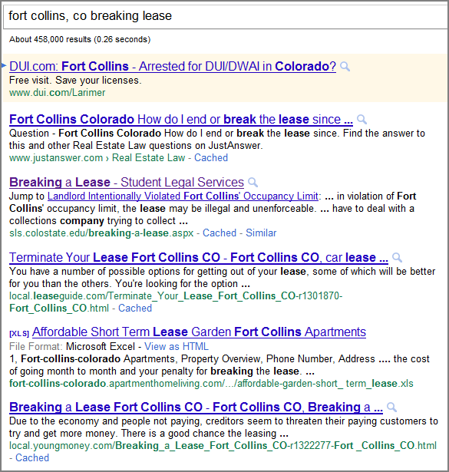
PHASE ONE RESULTS
Behavior & Expectations
Students start their legal research with google
The U.S. students all started with a google search. The Chinese student said he doesn’t use google and prefers to rely on “authority”. He started with the search box on the main CSU site.
Students are comfortable with natural language search queries, including misspellings. Example searches include:
fort Collins mip laws
alcohol possession laws
how to cancel a lease contract
do both partys have to cancel a lease
getting pulled over my rights
Colorado DUI penalties
colorado dui my rights
my dui experience (to get to blog of someone’s actual experience)
ft Collins co leasing rules
I don’t like my roommate, fort collins, co
leasing agreements in fort Collins
mip fort Collins
mip colorado
minor in possession Colorado
terminating a lease
Like most web users, students didn’t go to the second page of search results. They tended to click on the top 3 or 4 links, preferring .org or .gov sites to .com sites. If they didn’t quickly see what they wanted, they tried a different search.
For this search, the CSU SLS site came up #3 in google results and student clicked on it right away.
9

Slide 10
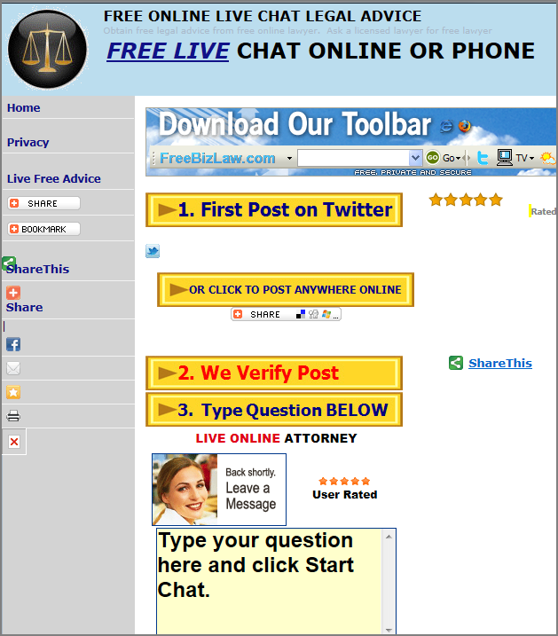
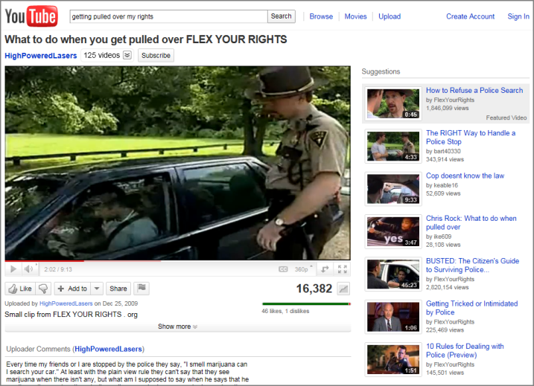
PHASE ONE RESULTS
Behavior & Expectations
Search versus browse
When directed to the CSU site or if they landed on other .org or .gov sites through google, students didn’t have much patience for browsing the site. Instead, they quickly went to the search box.
On www.fcgov.com/municipalcourt/, one student typed “dui fc” in the search box. He didn’t find the bulleted list of information he was seeking.
Immediate help
Students wanted to get immediate answers to their questions rather than making an appointment with Student legal Services and coming into the office
One student tried a couple of free legal chat windows.
Several students expected to be able to send an e-mail to SLS to get answers to their questions. They were a little put off by the message that pops up when they selected Contact Us.
One student opened up this live chat window to get immediate answer s.
Video
Some students spend a lot of time on YouTube. One student found this video a helpful way to learn what to do when pulled over by the police.
Social media (Facebook, twitter)
Most of the students use Facebook to connect with friends, but were quite unenthusiastic about going there to learn about legal issues. Fewer of these students follow twitter – and reacted similarly when asked about SLS-generated tweets.
10

Slide 11
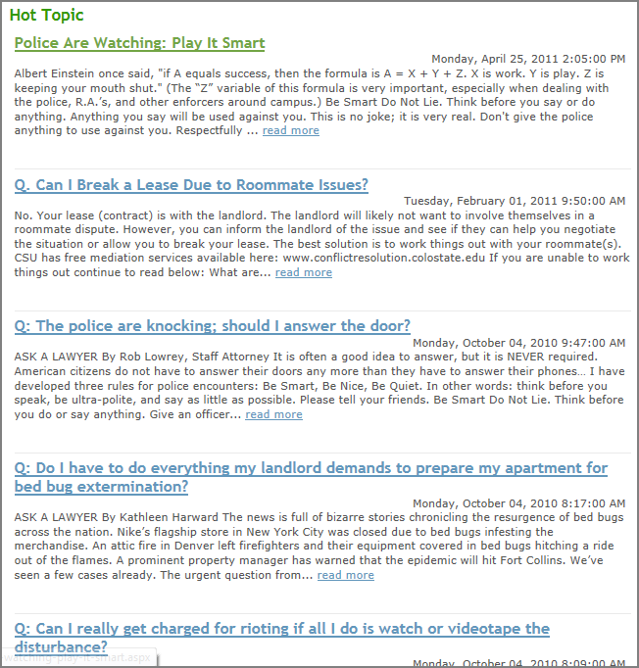
PHASE ONE RESULTS
Feedback on SLS Site
Good News
Areas of Improvement
The main topics on the SLS home page were clear: Consumer, Criminal, House, and Other.
Once they were pointed out to them, students liked the “hot topics” found on the home page. The information was interesting, relevant and in “bite sized pieces”.
When students got to the right web page, such as “Breaking a Lease” , “Minor in Possession” and “Driving While Under the Influence”, the level of information was “about right.”
Students like information they can easily scan, so bulleted lists worked well. They liked being able to print and use sample forms, such as lease documents.
On the home page, it’s not clear that legal services are free to CSU students. Most students didn’t realize these services were covered as part of their fees – and that’s an important message to convey.
The “Hot Topics” fall just before the fold so students didn’t scroll down to read them.
One past the home page, students couldn’t easily browse the SLS site to find topics. They didn’t know to look under Criminal Matters>Larimer County Court to find info on MIP or DUI.
If a page has sample forms (like the “Written Notice to Vacate” found in the Breaking a Lease page, it would be better to call them out as pdfs at the top of page rather than embed them.
For criminal matters, students wanted to see more procedural checklists, also information on what to expect in court.
There’s a lot of good information here with good headings. I like sub-links and example forms which are useful, because we don’t know what we’re doing.
~ Senior, while looking at the Breaking a Lease page
11

Slide 12
PHASE TWO RESULTS

Slide 13
PHASE TWO RESULTS
Legal Issues Important to Students
Most Important
Also Important
One of the most important issues relate to housing:
Landlord/tenant problems
Roommate issues
Safety concerns, e.g., domestic abuse with roommate
House maintenance
Contracts for off-campus living
Damage deposit
Negotiating leases
Getting out of lease if roommate bails
Landlord showing up unannounced or coming into apartment
Equally important were questions about dealing with the police:
What are my rights in dealing with the police?
Talking too much when police show up
Letting police into the house
When to call the police
Students also wanted help in handling noise violations. They mentioned the party packs distributed by Off Campus Life.
There are also issues unique to international students, who may not be as familiar with U.S. laws or legal processes, e.g., such as knowing the legal drinking age.
In the first focus group, students brainstormed a list of important legal issues and then voted on which ones were most important.
Students didn’t realize…
If I received a Minor in Possession ticket, the first thing I would do is go to the police ask them for help in how to cancel the history or do less damage. The police have the best idea. I wouldn’t think to talk to an attorney.
~ Chinese Student
…they could also get help in preparing for a trip abroad or
dealing with life issues such as purchasing a car, dealing with credit problems or writing a will
13

Slide 14
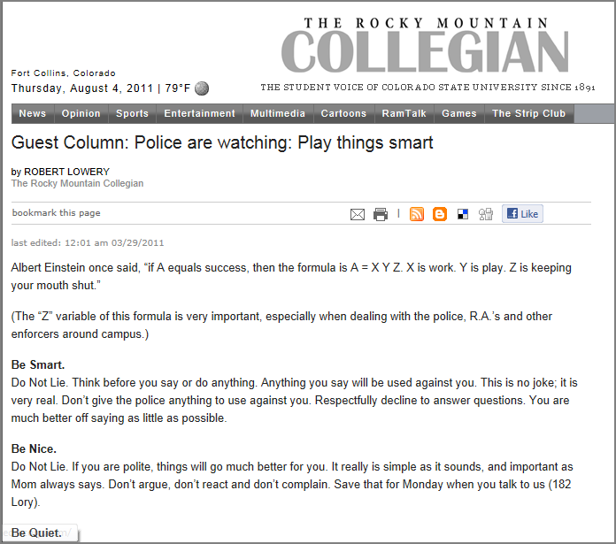
PHASE TWO RESULTS
Feedback on Current Outreach Efforts
Good News
Areas for Improvement
Those students who had interacted with Student Legal Services had a good experience.
Majority of older students (not freshman and sophomores) were aware of SLS.
A couple of students still had playing cards with info about SLS.
One student mentioned attending an SLS presentation.
None of the students remembered reading the SLS columns in the Collegian:
Didn’t like the graphic
Titles not catchy enough
Wrong placement in the paper; better on the back page or near the police report
These students didn’t remember seeing the SLS cards on the tables in the Student Union.
14

Slide 15
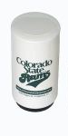
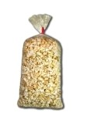
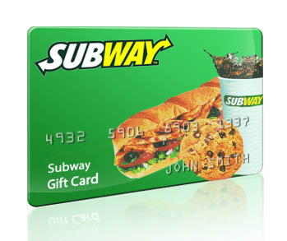
PHASE TWO RESULTS
Ways to Get the Word Out
Presence on the Plaza
Some of the first suggestions made were to take advantage of events and happenings on the plaza:
Piggyback onto other big events, such as recycling, job hunting fairs, etc
Give-aways are always good; can’t go wrong with food such as a bag of popcorn stapled with a legal tip.
Posters
Several students suggested posters displayed around campus:
Need to be visually eye-catching with graphics and photos
Short, to-the-point messages
Contain “weird” or interesting statistics, e.g. did you know that…?
Highlight that SLS provides free legal advice to CSU students
Suggested placement: dorms, rec center, TILT building (outside of classrooms), sporting events
You can’t go wrong with food if you want student attention. Reaction was more mixed about t-shirts; not all students are willing to advertise for an organization. Other suggestions for give-aways were water bottles and frig magnets.
Trivia Quiz via Campus e-mail
Many students quickly responded to SLS e-mail request to participate in this research effort. Students check their campus e-mail and suggested sponsoring short trivia quizzes…
…with give-aways for participating or enter to win a drawing for larger prizes such as iPod
that educate on legal topics
that take less than 2-3 minutes to complete
15

Slide 16
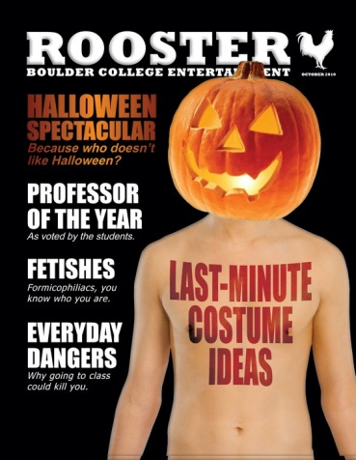
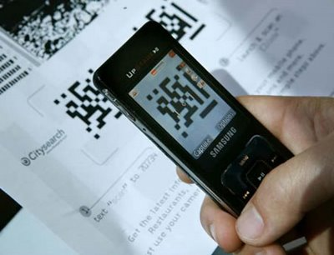
PHASE TWO RESULTS
Ways to Get the Word Out
Back page of Collegian
Rather than a column in the editorial section, students suggested advertising on the back page of the Collegian, near Ram Talk or the Sudoku puzzle:
Quick facts or provocative headlines (like the hot topics)
Consider embedding a QR Code with link to website to learn more
A couple of students also suggested writing a column in the Boulder Rooster magazine; it’s edgy, gets passed around, and contains an “interview with a lawyer section”.
Targeted Messages
For students in the dorm, encourage RAs to mention SLS in their floor meetings and hand out fliers
Table pamphlets in the dining halls for freshman
Orientation for incoming freshman and graduate students
For international students, include fliers in their apartment life packets (they are more likely to read them than other students)
Fliers or cards focused on housing issues at the spring housing fair or roommate roundups
Fliers at sorority and fraternity chapter meetings
Speak at student council meetings or other student groups, such as engineering groups
Social Media
QR Codes are fairly new technology and might interest some students; quick way to link to SLS website. Can also be effective on posters, as well as in newspaper and on fliers..
It’s hard to get students to “like” or “follow” an organization such as SLS. It’s better to piggyback onto the more established campus Facebook pages and twitter feeds. Or, consider placing a Facebook ad targeted at CSU affiliates.
16

Slide 17
RECOMMENDATIONS

Slide 18
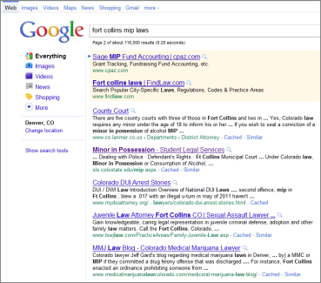
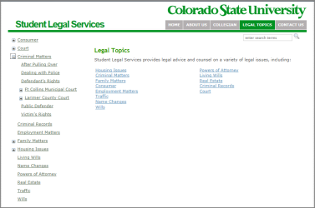
RECOMMENDATIONS
SLS Site
Screen/Topic |  | Finding | Opportunity | Rating*
Google Search |  | When SLS page came up near the top of their google search results, students found what they were looking for easily. Otherwise, students didn’t think to go to the CSU site to look for answers. | Improve the search engine optimization (SEO) of the SLS site: Work with CSU web team to ensure proper mark-up of the pages. For example, incorporate key search terms (including abbreviations such as “mip” and “dui”) into the title, header, and description tags. Set up google analytics, if they aren’t already in place, in order to track website traffic and effectiveness of outreach efforts. Conduct SEO key word research to identify high traffic/high value search terms that are relevant to SLS content. Improve page rankings by increasing the number of backlinks to the site. That is, reach out to other CSU departments and ask them to link to SLS relevant pages. Do the same thing with fcgov site (for landlord-tenant issues) and other related .org and .gov sites. | 4
Topics Menu |  | Students had a difficult time finding information on MIP and DUI by browsing the legal topics. It wasn’t intuitive to select Criminal Matters>Larimer County Court. | Reorganize the topics at the high level to reflect the most common student issues in terms they can relate to. For example: Underage Drinking>Minor in Possession (MIP), Underage Drinking & Driving, etc Drinking and Driving> DUI, DWAI, Driving Violations>Reckless Driving, Traffic Tickets Be consistent in providing navigation “bread crumbs” when navigating through the menu hierarchy. They appear in most page under House Issues. | 4
* Issues are rated on a 5-point scale: 5=critical issue that prevents most users from accomplishing goal; 1=minor issue that may be distracting to a user
18

Slide 19
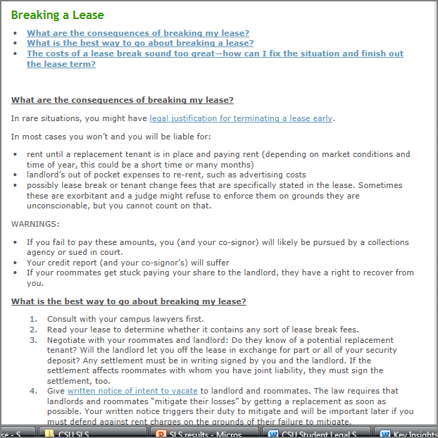
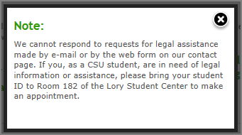
RECOMMENDATIONS
SLS Site
Screen/Topic |  | Finding | Opportunity | Importance Rating
SLS Home page |  | Students liked that the home page contained graphics and was easy to scan. However, the text at the top of the page didn’t state that the legal services were free to CSU students. That’s important to them. In one of the focus groups, students wanted more information how how far SLS would take a case, e.g. didn’t think they would handle a divorce for free. They also said it would be helpful to see a list of some of their different types of cases. For example, they didn’t realize SLS would help prepare for a trip abroad. Also, they didn’t see the “Hot Topics” at the bottom of the page. | Improve the layout and content of the home page: Reduce the size of the graphic at the top of page so that more of the Hot Topics are visible without scrolling. Revise the copy so make it clear that legal services are free to students and that all consultations are with an experienced attorney versus a law student. Provide more description of how SLS works and the types of cases handled. Ensure that the main topics on the home page are in sync with the re-organization of the legal topics menu. On the home page, highlight the most common student issues. Might consider adding a Q&A section. Consider renaming the Collegian menu item to “Hot Topics”. | 3
Page Layout |  | Students liked information presented in bulleted or numbered lists to make it easy to scan. They also liked the links at the top of the page if there was a lot of information. They also liked seeing example documents or forms, such as a lease agreement. However, in the case of the Breaking a Lease page, the example was embedded into the content of the page and that was confusing. | Format an area at the top of page for links to pdf forms or sample documents, where applicable. | 2
Contact Us |  | Several students clicked on the Contact Us button and were put off at the pop-up message that appeared. They wanted immediate help and may not come into the SLS office. | Consider using a different e-mail approach: Allow students to e-mail office in order to make an appointment. If students want advice via e-mail on a common issue, respond with links to information on the SLS site or other reliable resources, such as link to campus site or fcgov site, while also encouraging them to come into the office . | 3
19

Slide 20
RECOMMENDATIONS
Getting the Word Out
Try some new approaches
E-mail campus-wide short trivia quizzes focused on specific legal topics. Can also post quiz on main campus Facebook page. Relatively low-cost campaign. Also easy to track responses.
Look into advertising costs in the Collegian for a brief ad on the back page, containing an interesting legal fact or provocative headline, e.g. “Could you be a sex offender?” Embed QR Code to send students to website for the full article. Track web traffic through google analytics to gauge effectiveness.
Partner up with graphic design department to create visually interesting posters with brief, targeted messages.
Tweak what you’re already doing
Continue to have a presence on the plaza when students gather for other events.
Target students , such as international students, with fliers and presentations.
Submit an existing Collegian article to the Rooster.
20

